Slide 1
Quantum Chess Bot
Title: Training Chess Bot
Subtitle: Leveraging AI for Intelligent Chess Strategies
Theme : AI Driven Chess Training Bot.

Slide 2
Methodology
Data Collection: Games from grandmasters and chess databases.
Model Selection: Choose between Stockfish-based algorithms or reinforcement learning.
Training: Supervised learning and reinforcement learning.
Evaluation: Playtesting against human and AI opponents.

Slide 3
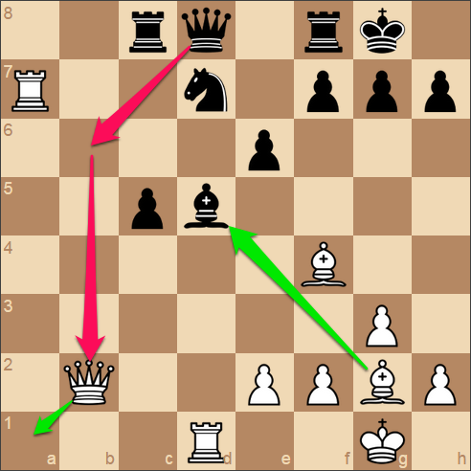
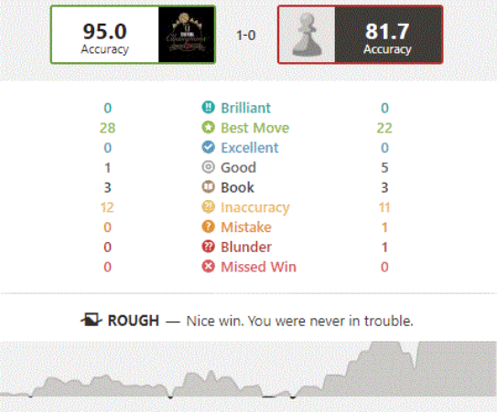
Proposed Solution
Chess Bot Evaluating Positions
Chess Bot After Match Evaluation for Training

Slide 4
Technical Approach
Creating a chess Bot and Evaluating requires AI Algorithms:
Used stockfish Chess Engine.
1) Min – Max Algorithm:
Best to find optimal move in two player game.
It is backtracking algo used in decision making providing optimal move.
Provides depth-first algo for complete tree.
2)Alpha Beta Pruning.
Used for finding the minimum solution.
Modified version of MinMax algorithm.
Alpha : The best (highest-choice) in path.
Beta : The best (lowest-choice) in path.

Slide 5
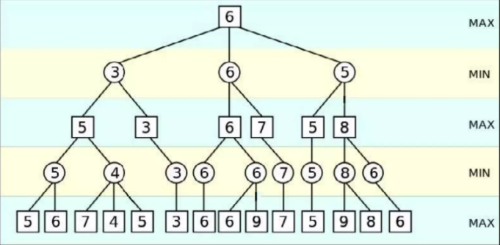
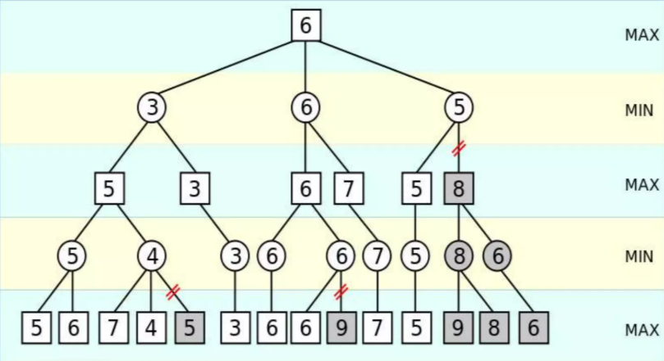
Algorithm Visualization
MinMax Algorithm Graph. MinMax with Alpha Beta Pruning Graph.

Slide 6
IMPACT AND BENEFITS
Benefits :
Helps players improve their chess skills through AI training.
Enables analysis of game patterns and strategic insights.
Provides an interactive and engaging learning platform.
Can be used for competitive training and professional chess coaching
Conclusion :
Chess bot training involves AI, deep learning, and reinforcement learning
Successful implementation can help players refine their strategies.
Continuous improvement is key for achieving human-like gameplay.

